Slide 1

Naren Rakesh Venkat Chandra Jayanth

Slide 2
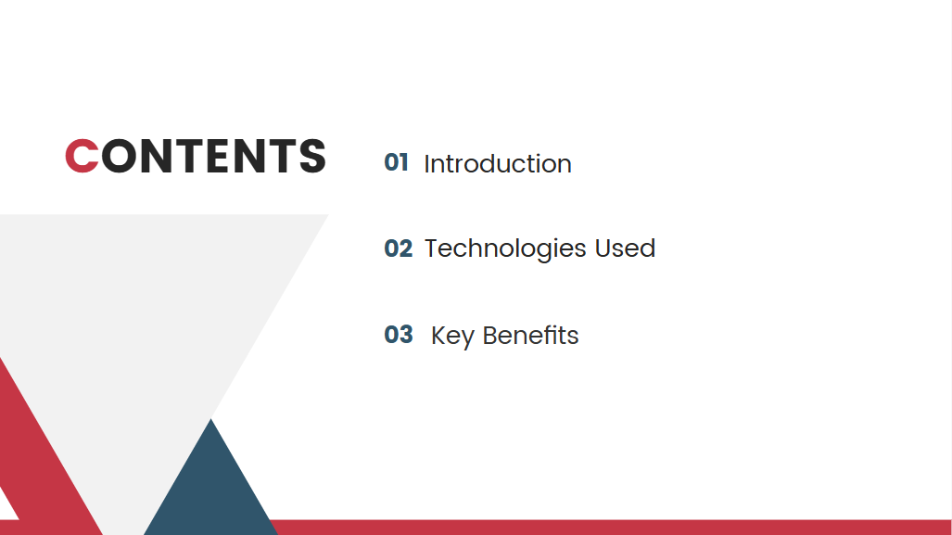

Slide 3
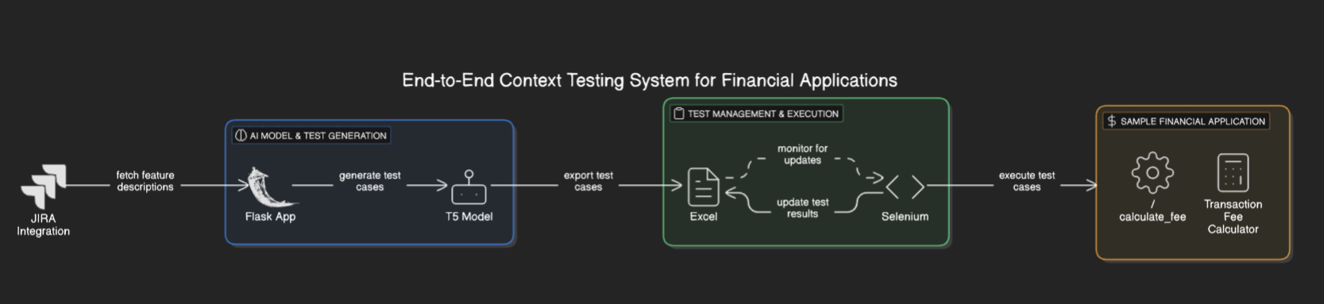
Flow Diagram :

Slide 4
System Architecture
T5 Model
Training the T5 Model
Test Case Generation
Exporting Test Cases to Excel
Automated Test Execution with Selenium
Sample Financial Application (Transaction Fee Calculator)

Slide 5
System Flow
Training the T5 Model
Generating Test Cases
Exporting Test Cases
Automating Test Execution

Slide 6
Technologies Used
Component | Technology Used
AI Model | T5 Transformer (Hugging Face)
Backend | Flask
Frontend | HTML, CSS
Test Case Management | Excel (Pandas)
JIRA Integration | JIRA API
Automation | Selenium, Watchdog
Sample App | Flask (Transaction Fee Calculator)

Slide 7
Key Benefits
✅ Automated Test Case Generation – AI-based test case generation reduces manual effort.
✅ JIRA Integration – Ensures real-time synchronization with product features.
✅ Excel Export & Monitoring – Simplifies test case management.
✅ Automated Execution – Selenium automated test case execution and validation.
✅ Scalability – The system can be extended to other financial applications.

Slide 8


